Slide 1

Identifying Experts in Community Question Answering Website Based on Graph Convolutional Neural Network
Ayush Mangukia, Mohammed Ibrahim, Soorya Golamudi, Niraj Nandish

Slide 2
Introduction
Google processes over 3.5 Billion searches every day. This staggering number is since anyone can almost get every solution on the world wide web.
Our project helps in making the process of finding out the answer much more comfortable and efficient.
The first goal is to find experts in specific fields. Using neural network methods we can identify experts and designate them to their respective practice.
The second goal is to make an interface allowing users to present their questions. Our project will not only help save time but also remove the unnecessary guesses put out by non-experts.

Slide 3
The Idea
Make a community question answering website
Build a model to find experts on the website
Integrate the Model into the Website

Slide 4
The Website
Back End
Flask
Front End React
Database
MongoDb
Image Database
Cloudinary
Target Platform
Web Browsers

Slide 5
Work to be done
Make a community question answering website using Flask as Back End and React as Front End, combining it with Mongo DB as the Database for Data and Cloudinary for Images. After this, we will analyze data using Machine Learning Techniques and sort users as Experts and Non-Experts.

Slide 6
Roles Assigned
Mohammed Ibrahim Implementing Machine Learning
Ayush Mangukia Back End
Niraj Nandish Front End
Soorya Golamudi Database Management and Testing.

Slide 7

Current work
We have linked up our Database set in MongoDb to our application using PyMongo and Cloudinary to use our Image Database set up in the Cloudinary Database.
We have linked a few APIs for Home Page, Login, Sign Up, Add Question, Update Question, Add Answer and upload Images to Cloudinary.
We also made an unsupervised model where Natural Language Processing has been used.
It’s a model that will basically try to regenerate the answers from scratch.

Slide 8
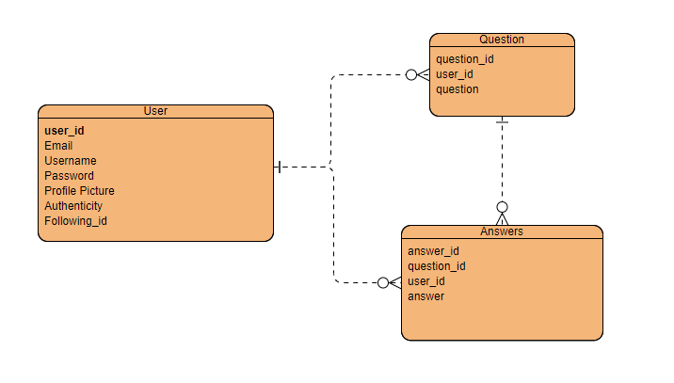
ER Model
We are using the given ER Schema for our Database.

Slide 9
Timeline
Plan out the Project
Training the Model for Expert Detection
Front End Linking with the API’s
Database Creation in MongoDB and Cloudinary
Testing with Data
Fixing Bugs
Make the Back End API’s

